Slide 1




Sales & Supply Chain Analysis Report
Technical Provider: AST
Instructor: Ahmed Abdellatif

Slide 2
Meet our team
Mohamed Shehata
Youssef Tarek
Hassan Hashish
Ibrahim Mohamed
Khaled Hossam

Slide 3
Agenda
Objective & Data Overview
Cleaning & Modelling
EDA with Python
Blueprint & Dashboards
Analysis Report
Recommendations

Slide 4

Objective
The goal of this project is to analyze the sales and supply chain performance of Data Co company to identify insights and key requirements by analyzing the performance over the past few years and providing decisions and recommendations for improvement to the company.

Slide 5


Data Overview
ANNUAL REVENUE GROWTH
The dataset contains 180,519 rows and 53 columns of data related to sales and supply chain operations, including product details, delivery times, shipping methods, customer details, sales information, and department details. The dataset contains only one fact table, so it needs to be normalized to reduce the data redundancy and make it suitable for data modeling. And there some cleaning and nulls to handle.

Slide 6
Cleaning & Modelling

Slide 7
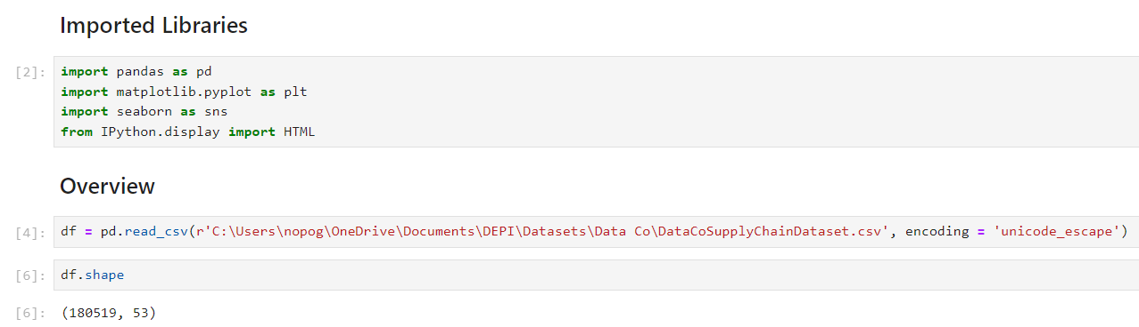
Cleaning & Modelling
First, we imported libraries like Pandas for cleaning, Matplotlib & Seaborn for visualization, and HTML for downloading the file after we finished cleaning. Then, we uploaded the file and checked the number of rows and columns, and there was 180,519 rows and 53 columns.

Slide 8
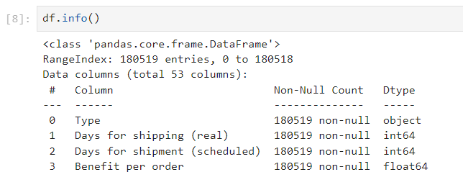
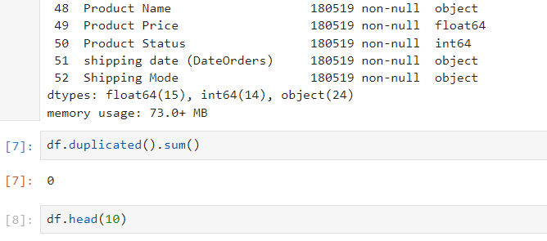
Cleaning & Modelling
Second, we checked each column for its data type and the number of null values. Then, we examined how many duplicates were in the data and reviewed the format of each column and deleted two columns that contained nearly 100% null values.

Slide 9
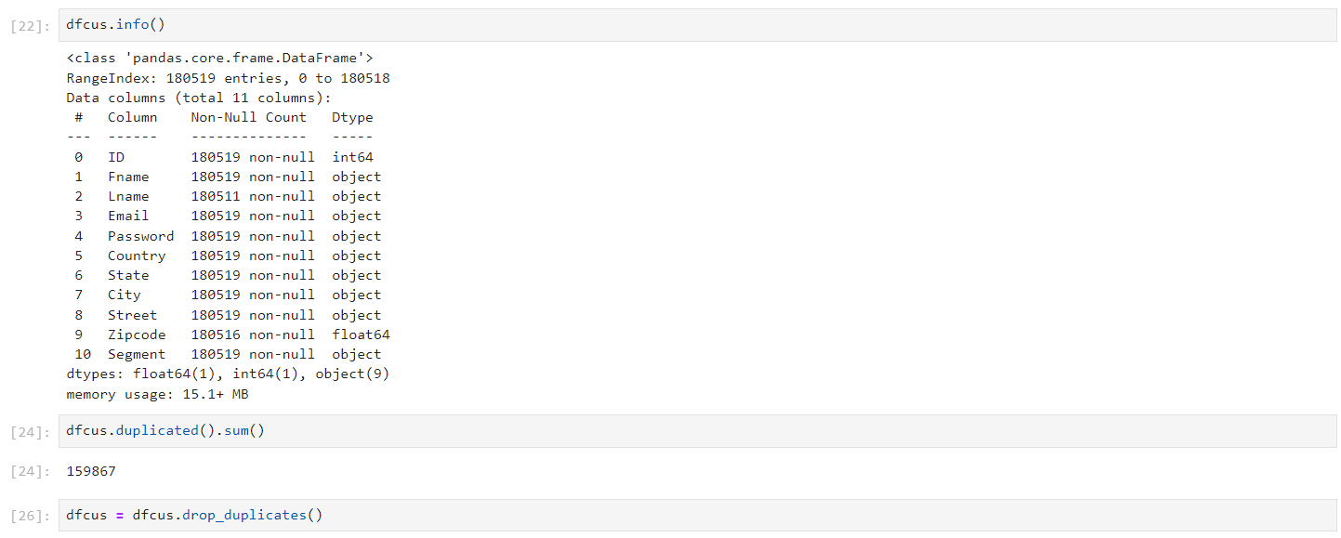
Cleaning & Modelling
Third, we created the customer table, which contained all the customer information. Then, we deleted duplicates from the table and ensured there were no duplicates in the customer ID, confirming that there were no multivalued attributes.

Slide 10
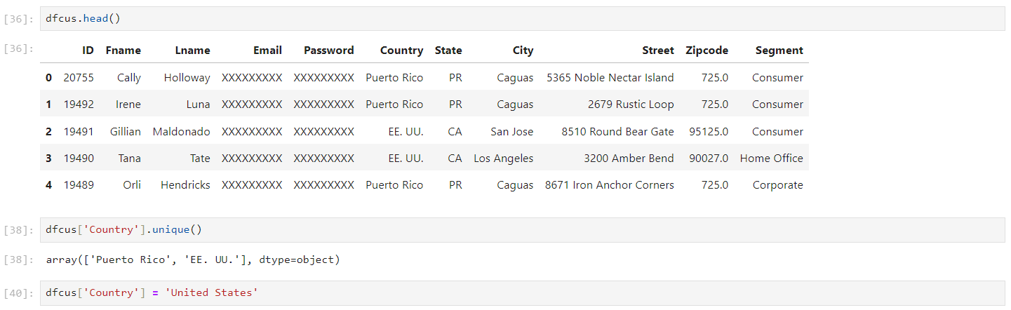
Cleaning & Modelling
Fourth, we checked the format and values in each column in the table, replacing any necessary values, whether they were garbage values or nulls values, and changed the column names if necessary.

Slide 11
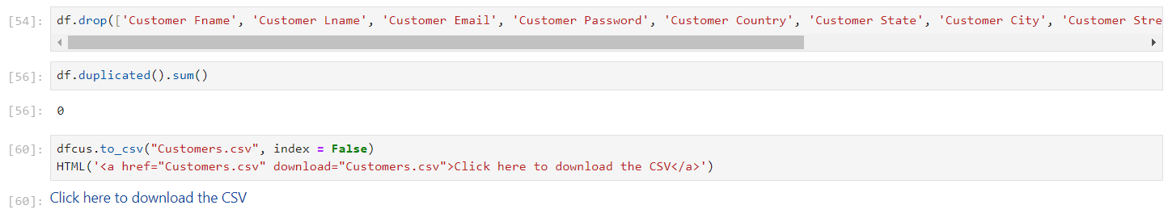
Cleaning & Modelling
Fifth, we deleted these columns from the fact table and once again ensured there were no duplicates in the fact table. Then, we downloaded the table as a CSV file.

Slide 12
Cleaning & Modelling
After applying all the previous steps to each table, we ended up with one fact table, which was the order table, and dimension tables, which included the customer table, department table, products table, and category table.
Order Table: 180,519 Row and 28 Column.
Customer Table: 20,652 Row and 11 Column.
Product Table: 118 Row and 5 Column.
Category Table: 51 Row and 2 Column.
Department Table: 11 Row and 2 Column.

Slide 13
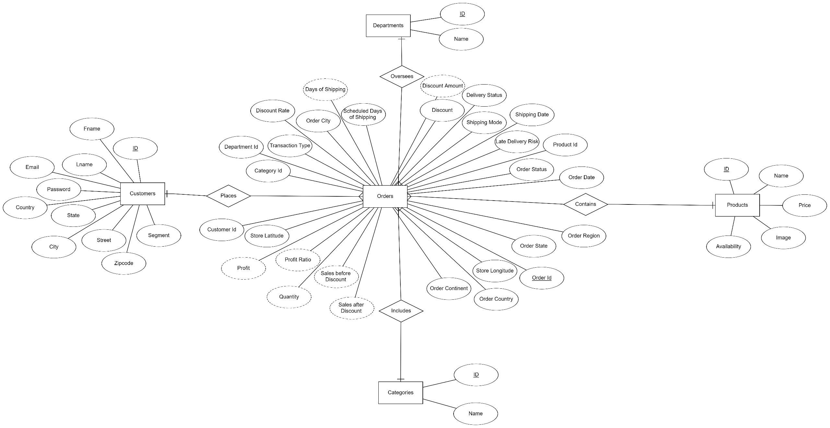

Slide 14
EDA with Python

Slide 15
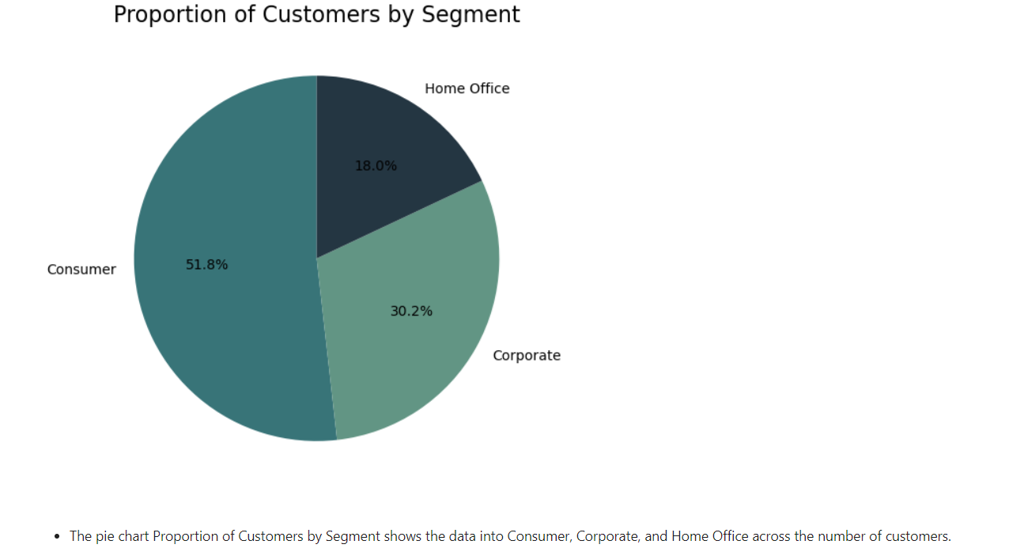

Slide 16
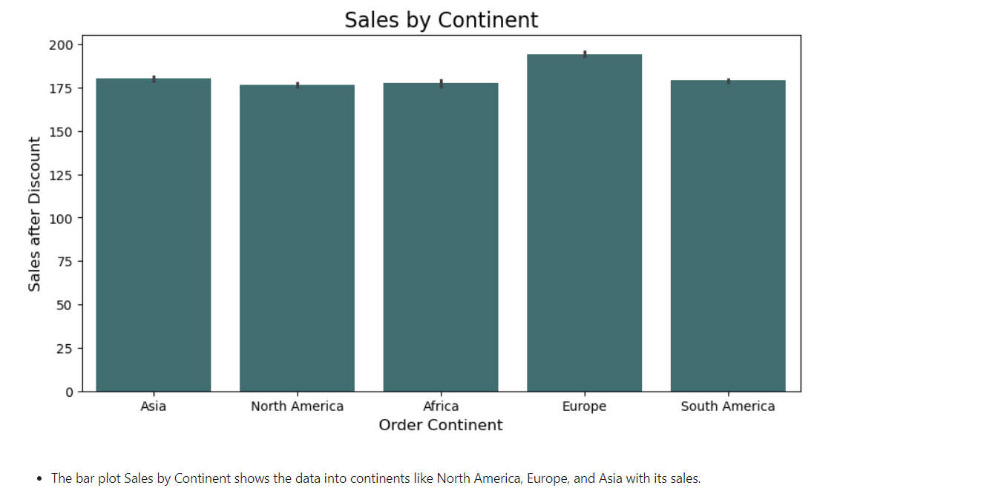

Slide 17
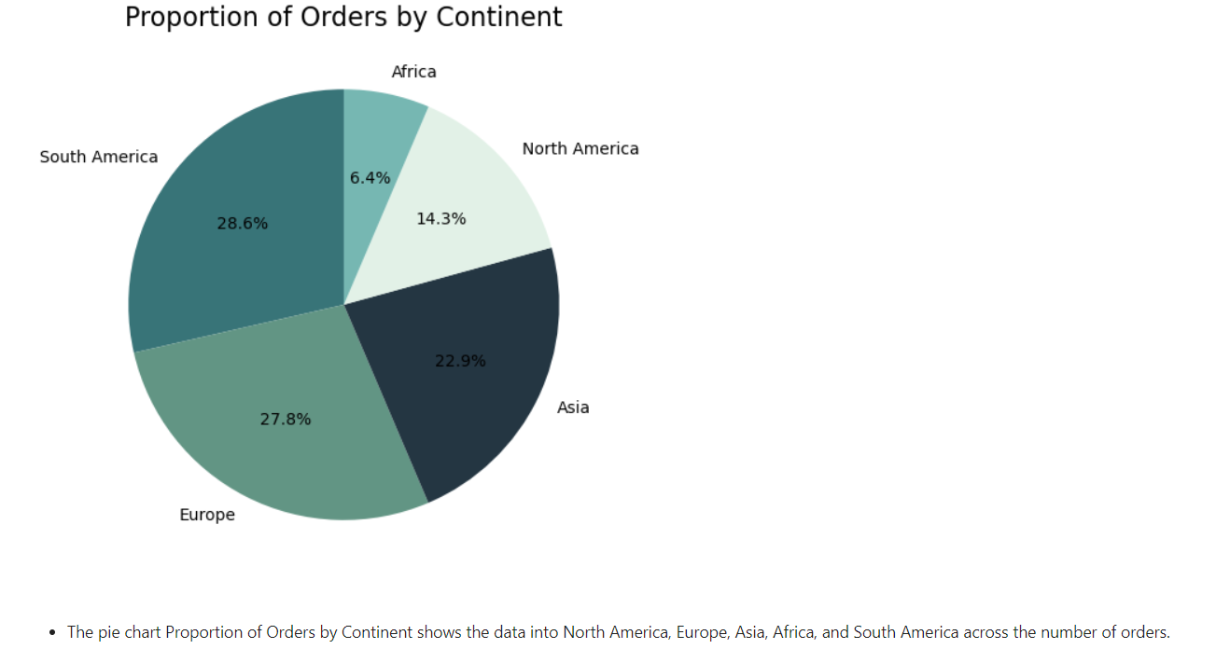

Slide 18
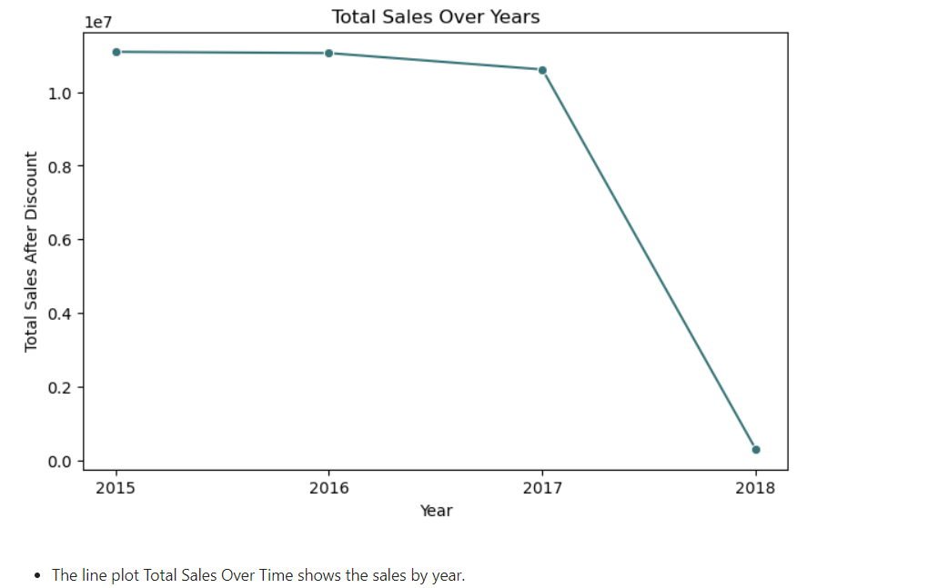

Slide 19
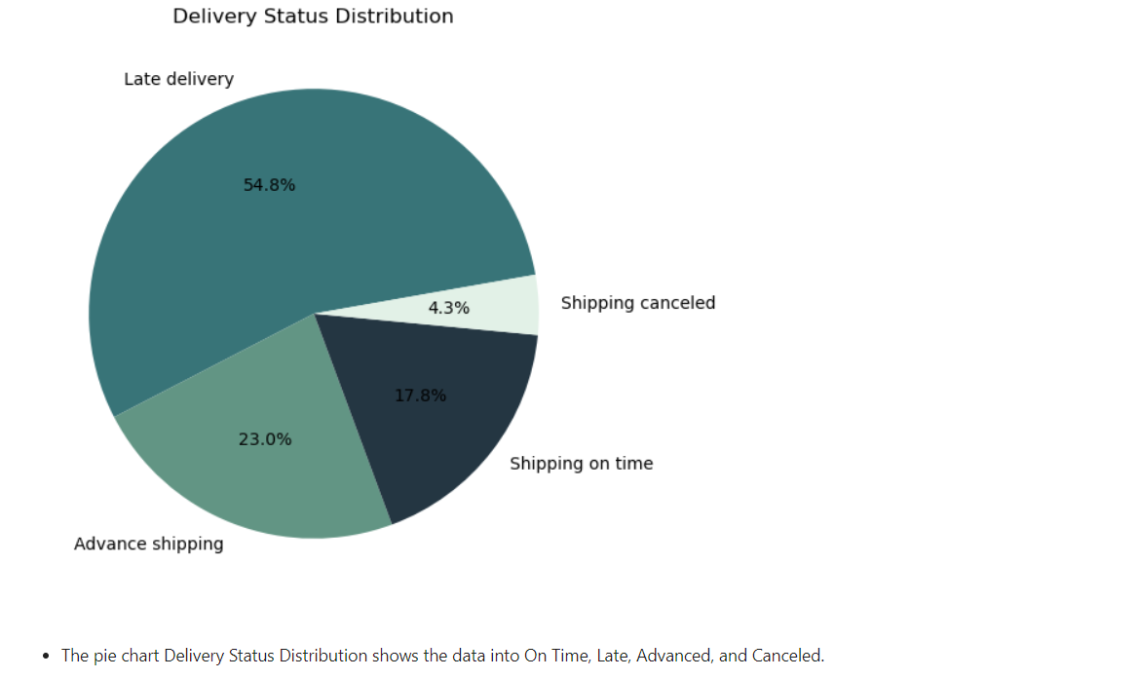

Slide 20
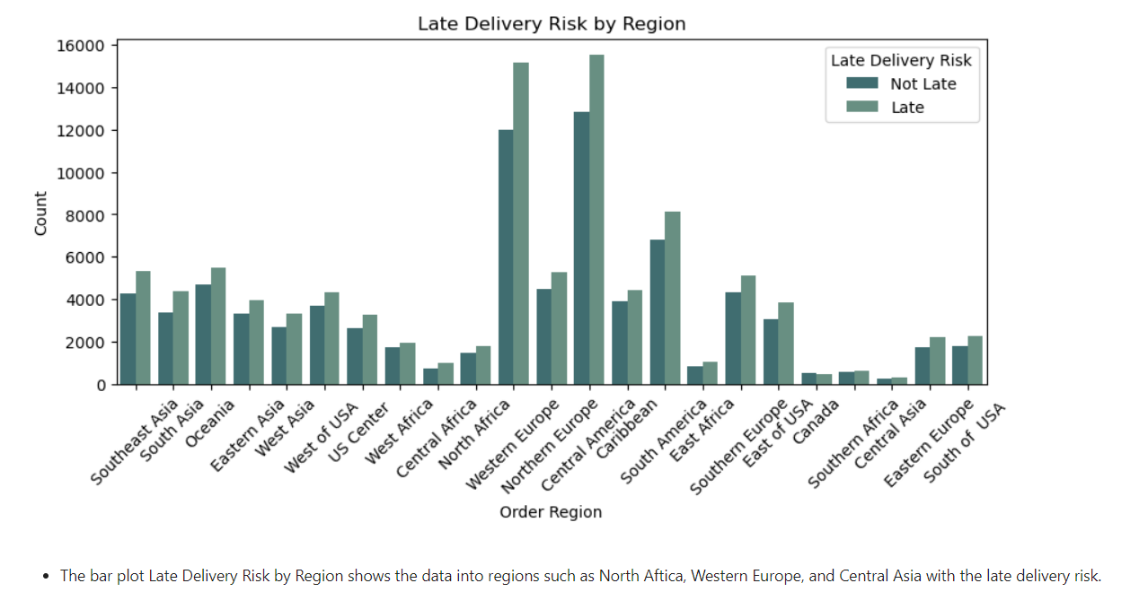

Slide 21
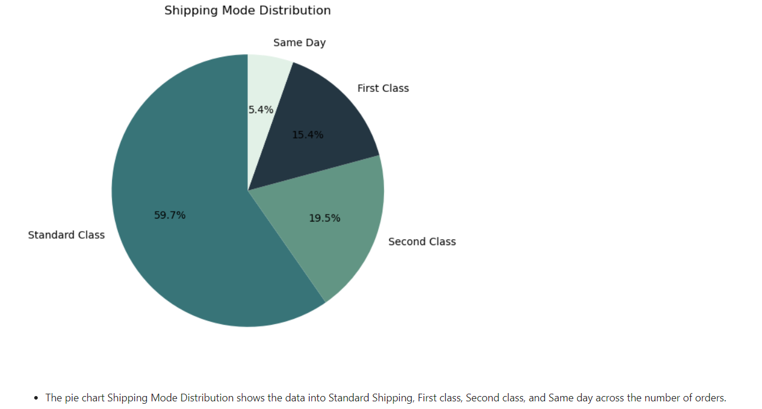

Slide 22
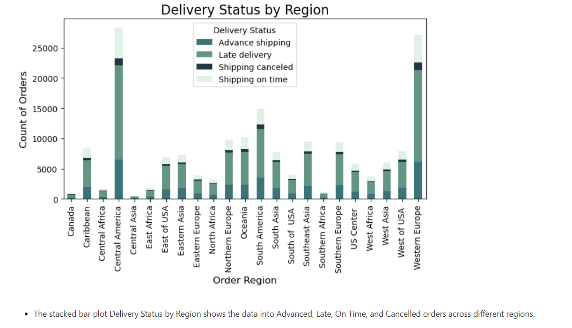

Slide 23
Blueprint

Slide 24
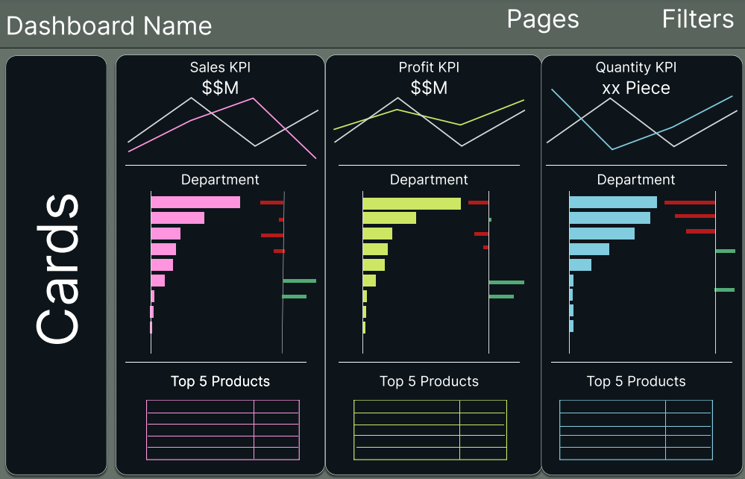

Slide 25
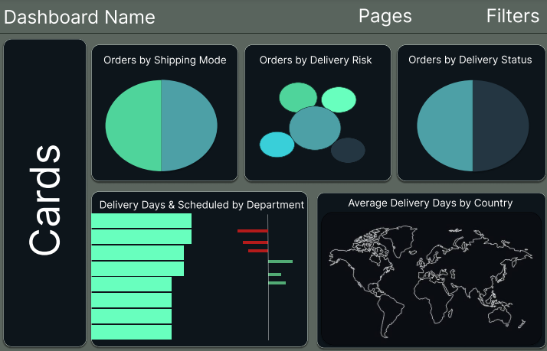

Slide 26
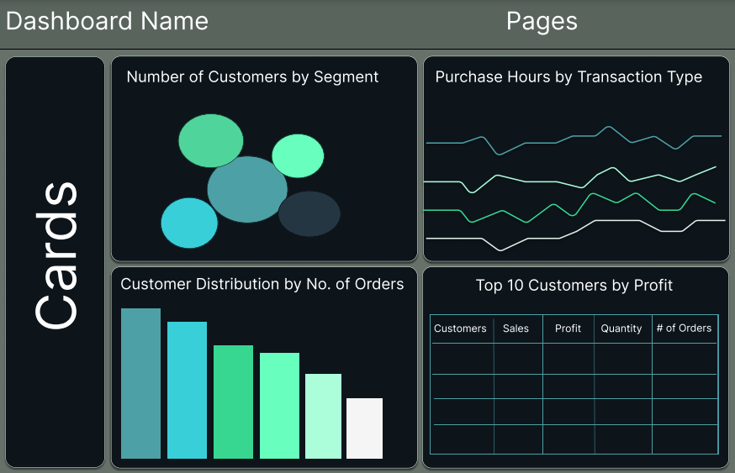

Slide 27
Dashboards

Slide 28
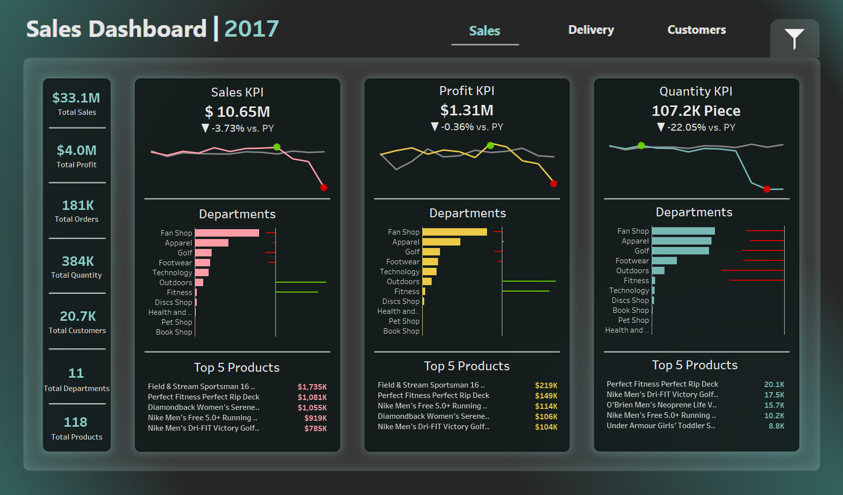

Slide 29
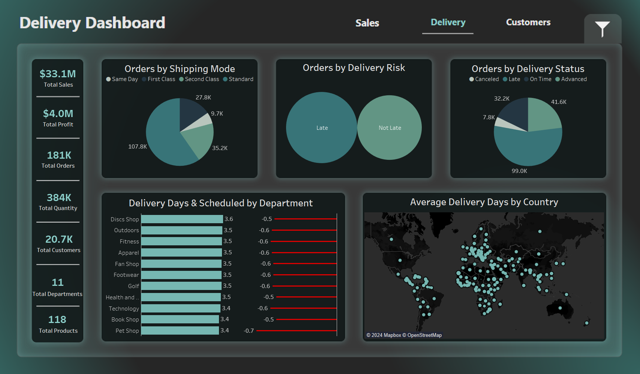

Slide 30
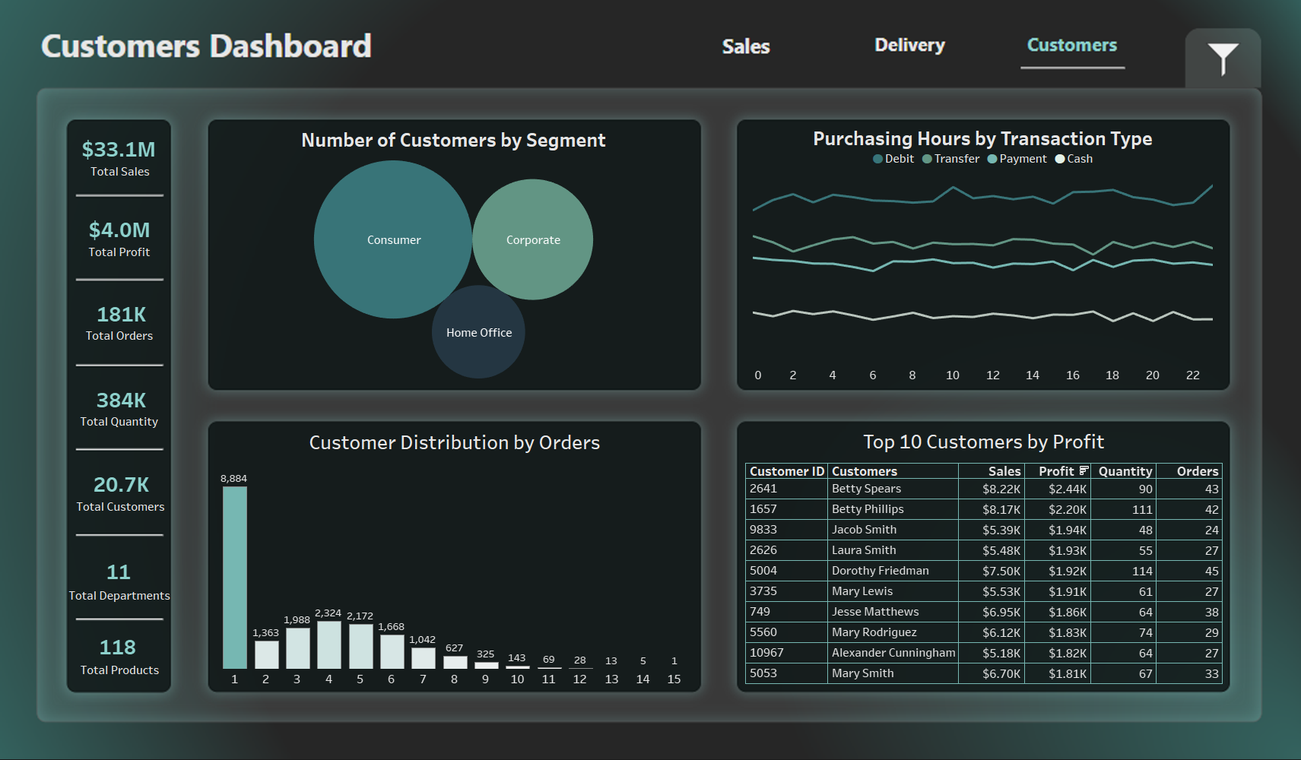

Slide 31
Analysis Report

Slide 32
Sales Dashboard
The dashboard shows our business performance for every selected year, focusing on sales, profit, and quantity sold. We made $10.65M in sales in 2017, but that’s a decline of 3.73% from last year, which is a bit worrying. The Fan Shop and Apparel departments did the best. However, they did better last year.
For profit, we earned $1.31M in 2017, showing a slight drop of 0.36%. This is similar to the sales trend, meaning our profits depend on how well we sell. The same departments lead in profit, but areas like Book shop and Pet shop are struggling. Additionally, we sold 22.05% fewer products, which raises concerns about customer demand or stock issues. This decline suggests we need to work harder to keep our customers.
To improve, we should find out why the quantity sold has dropped so much. We should focus on our successful departments like Fan Shop and Apparel. Focusing on our best departments can also help reduce this declines and improve the business. With these changes, we can aim for better growth in the future.

Slide 33
Delivery Dashboard
The Delivery Dashboard provides a clear view of our delivery operations and reveals several important findings. One major issue is that nearly 25% of our orders are delivered late, which can frustrate customers and hurt our business. While a large number of deliveries are on time, we need to focus on improving our late deliveries. This could involve better planning and partnerships with shipping companies to ensure items arrive when promised.
Another finding is that most customers use standard shipping, which is the cheapest option. However, this can lead to longer delivery times. We should promote faster shipping options, like First Class or Same Day delivery, to improve customer satisfaction. Offering these methods could encourage more customers to choose them, helping to reduce delays.
Additionally, the dashboard shows that average delivery time is always less than scheduled. By identifying and addressing the reasons for these delays, we can improve efficiency. The geographical breakdown also indicates that delivery times can vary based on location. Targeting improvements in areas with longer delivery times can help us serve our customers better. Overall, these insights can guide us in making better decisions to enhance our delivery performance and boost customer satisfaction.

Slide 34
Customer Dashboard
The Customer Dashboard gives us important information about our customers and their buying habits. One key finding is that many customers only make one purchase. This shows we need to work on getting them to come back for more. Building customer loyalty is crucial because it’s often easier and cheaper to keep existing customers than to find new ones.
Another important point is that a small number of customers make up an important part of our profits and reputation. This means we should pay special attention to these customers to keep them happy. By offering them exclusive deals or personalized services, we can encourage them to shop with us again and again, which will help our business grow.
Lastly, the Home Office segment is much smaller than the Consumer and Corporate segments. Overall, the dashboard shows us where we can improve, especially in keeping customers, supporting our best ones, and reaching out to new segments.

Slide 35
Recommendations

Slide 36
Recommendations
After conducting the analysis, we recommend that the company focus on a specific value proposition, such as fitness, rather than expanding into unrelated departments like book shop, pet shop, Discs shop, Health and Beauty, and technology. These additions have made the company’s value proposition unclear, resulting in a loss of sales and customers. The departments that should be prioritized are apparel, footwear, golf, fitness, outdoors, and potentially the fan shop, while the rest should be closed. Then, we need to hire a delivery agency because the company takes more time than scheduled to deliver to the customers.
We also need to rebrand the company to match its new focus. The rebranding should highlight the main areas: apparel, footwear, golf, fitness, and the outdoors, while removing the other, less relevant departments. The goal is to create a clear and simple brand that connects with customers and helps the company grow in these key areas.
Lastly, we need to focus our marketing on our existing customers who align with our value proposition and segments. At the same time, we should target new customer segments through strategies like social media marketing. This will help us strengthen relationships with loyal customers, attract new ones who fit our brand, and build a trusted, well-known brand in the market.

Slide 37




Thank you
Technical Provider: AST
Instructor: Ahmed Abdellatif

